Slide 1
Hands on Machine Learning Jul 2022

Slide 2
Problem Statement - Titanic Disaster
While there was some element of luck involved in surviving, it seems some groups of people were more likely to survive than others.
In this challenge, we ask you to build a predictive model that answers the question: “what sorts of people were more likely to survive?” using passenger data (ie name, age, gender, socio-economic class, etc).
https://www.kaggle.com/competitions/titanic/overview/description

Slide 3
Data - Features
PassengerId is the unique id of the row and it doesn't have any effect on target
Survived is the target variable we are trying to predict (0 or 1):
1 = Survived
0 = Not Survived
Pclass (Passenger Class) is the socio-economic status of the passenger and it is a categorical ordinal feature which has 3 unique values (1, 2 or 3):
1 = Upper Class
2 = Middle Class
3 = Lower Class
Name, Sex and Age are self-explanatory
SibSp is the total number of the passengers' siblings and spouse
Parch is the total number of the passengers' parents and children
Ticket is the ticket number of the passenger
Fare is the passenger fare
Cabin is the cabin number of the passenger
Embarked is port of embarkation and it is a categorical feature which has 3 unique values (C, Q or S):
C = Cherbourg
Q = Queenstown
S = Southampton

Slide 4
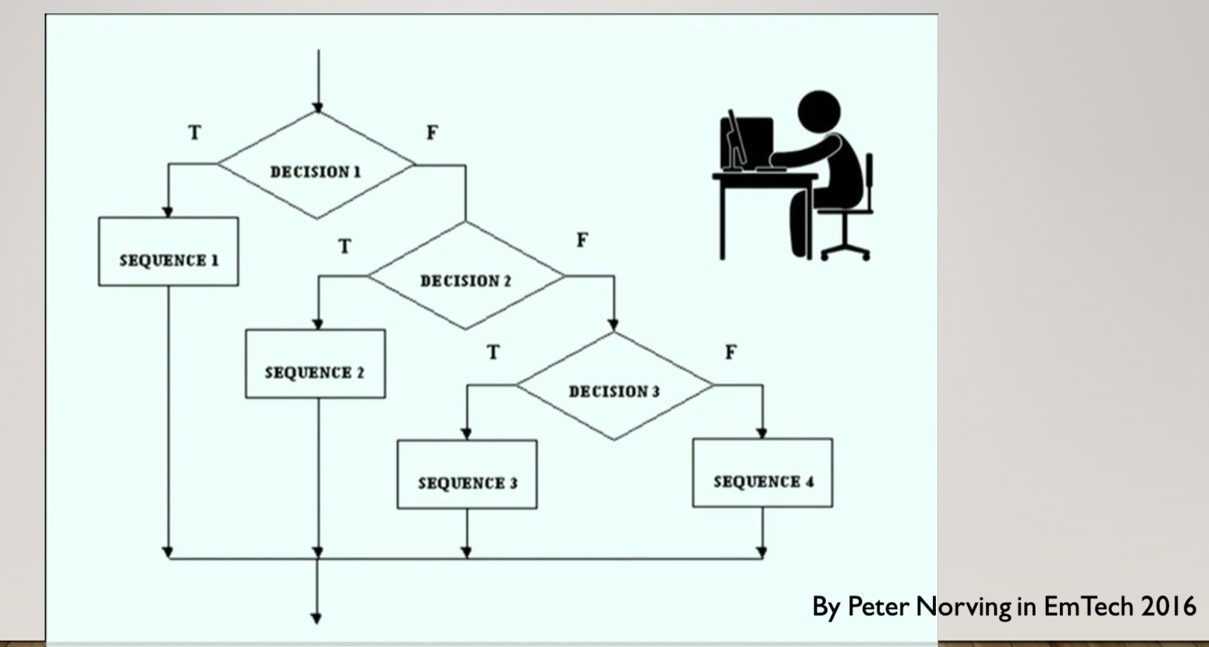
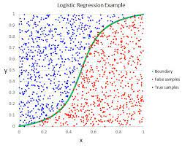
What is Machine Learning?
Traditional Programming - Rule based system
NEW DATA
DATA
ML ALGORITHMS
LABEL
PREDICTED LABEL

Slide 5
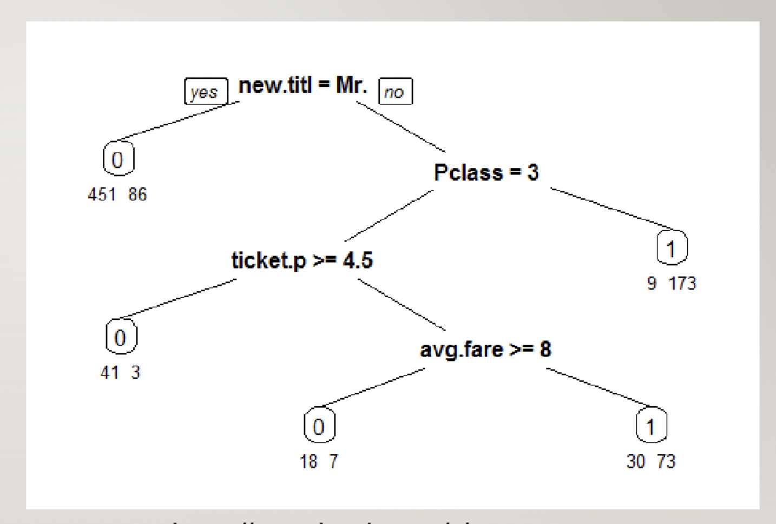
Supervised ML
Supervised Classification Problem
Output prediction is discrete classes (predict probabilities)
Yes/No
High/Medium/Low
Cat/Dog
Image Classification
Product categorization
Supervised Regression Problem
Continuous values
House Rent
Loan amount

Slide 6
H2O installation
Install JRE
Download h20
http://h2o-release.s3.amazonaws.com/h2o/rel-zumbo/3/index.html
cd ~/Downloads
unzip h2o-3.36.1.3.zip
cd h2o-3.36.1.3
java -jar h2o.jar
http://localhost:54321

Slide 7
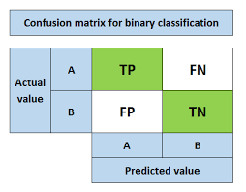
Metrics
For Classification
Accuracy – What % is correct (not suitable for imbalance dataset)
Precision - Quality
Of the ones predicted as True, what % is actually true.
TP/ (TP + FP)
Recall - Quantity
Of the ones which are actually positivem how much are predicted correctly
TP/ (TP + FN)
F-Score
Balance between both precision and recall.
For Regression
MAE, RMSE, MAPE, WMAPE, Bias %
Questions:
Of 100 patients, 10 have cancer. Model predicts everyone has cancer? What is accuracy?
ML Model for Criminal justice - what is important - Precision or Recall?
Model to predict Covid or not - Precision or Recall?

Slide 8
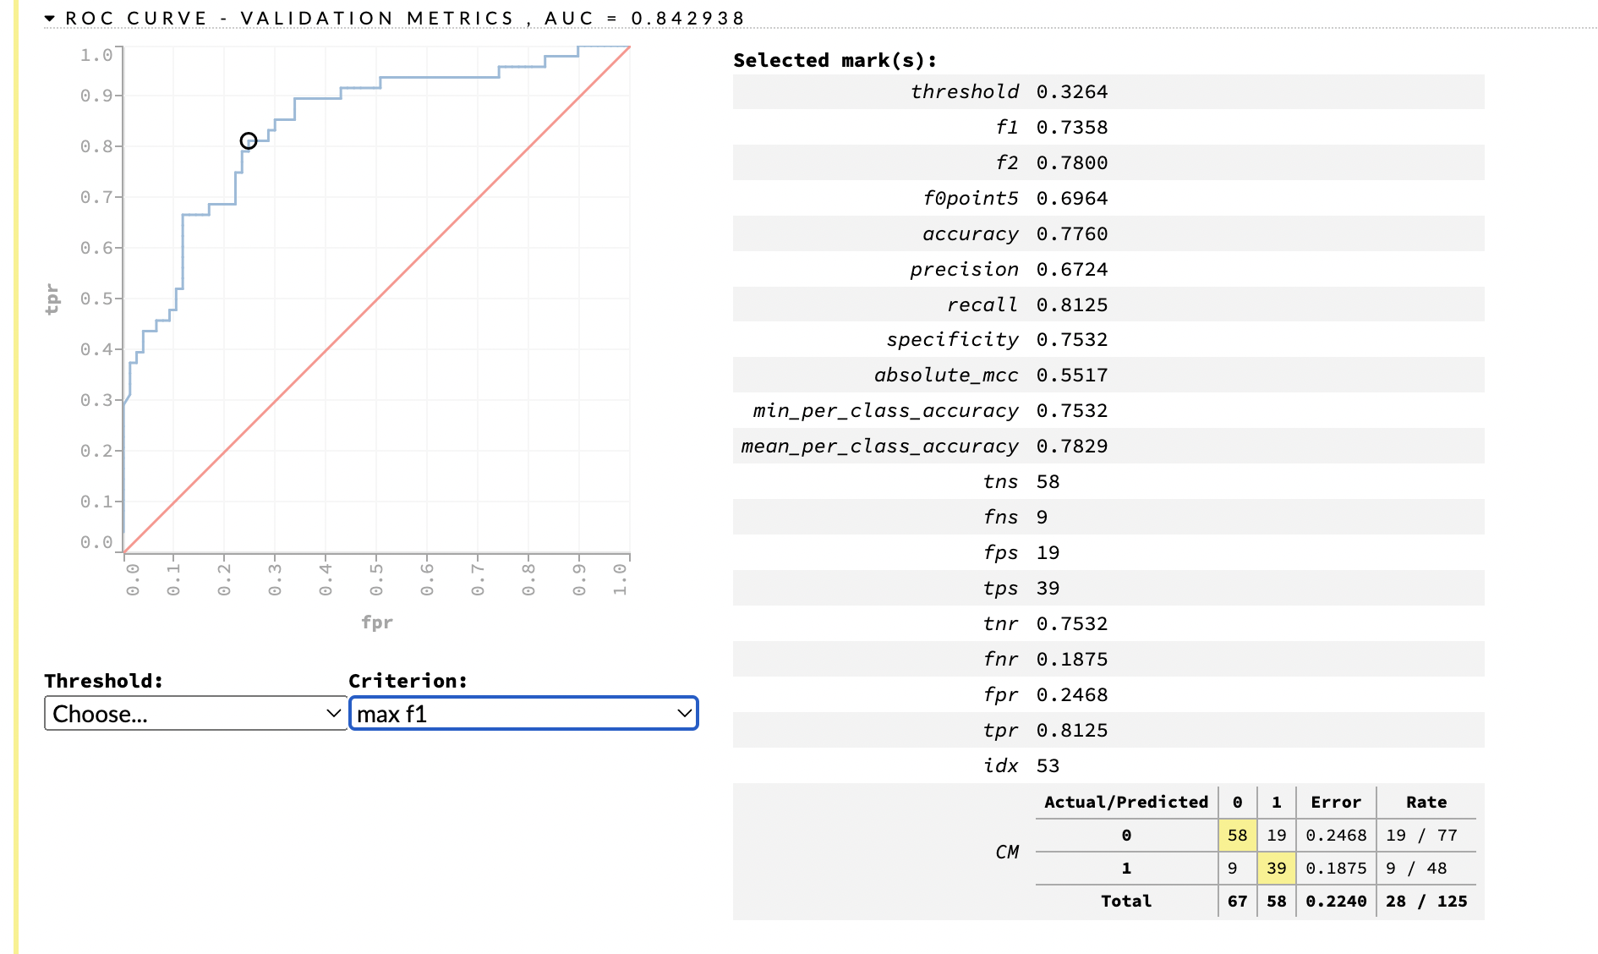
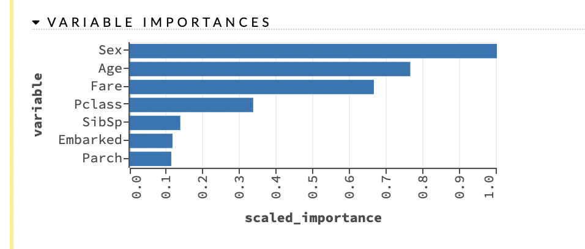
First Model

Slide 9
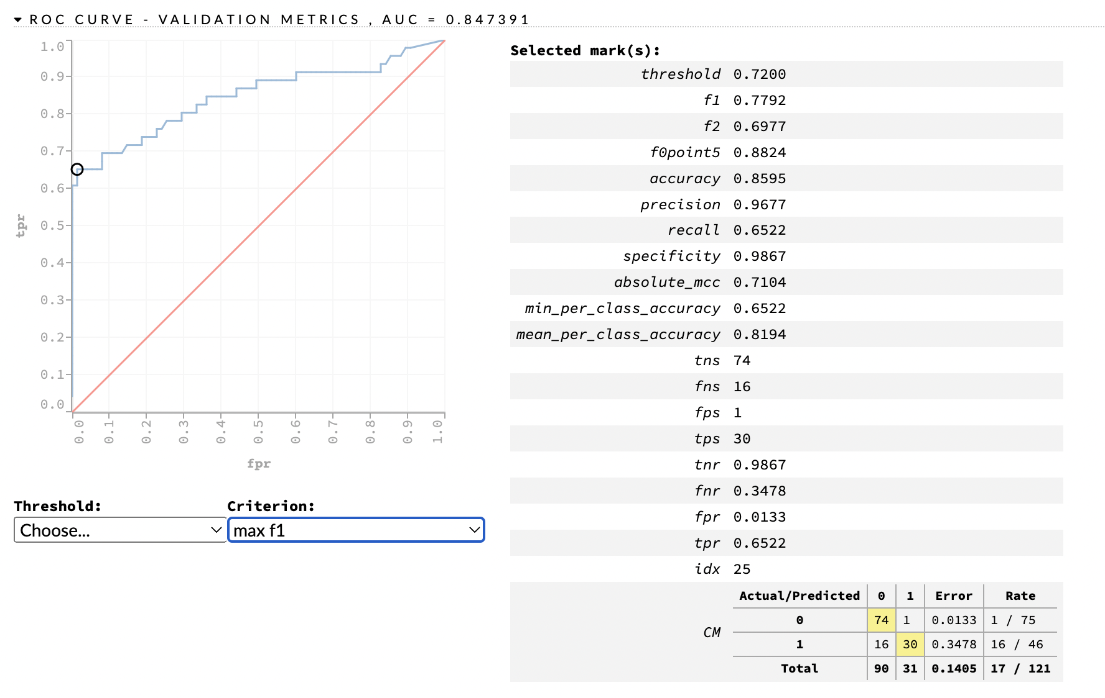
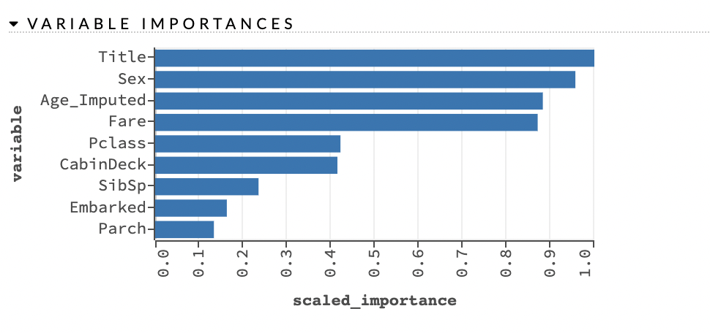
Feature Engineered Model

Slide 10
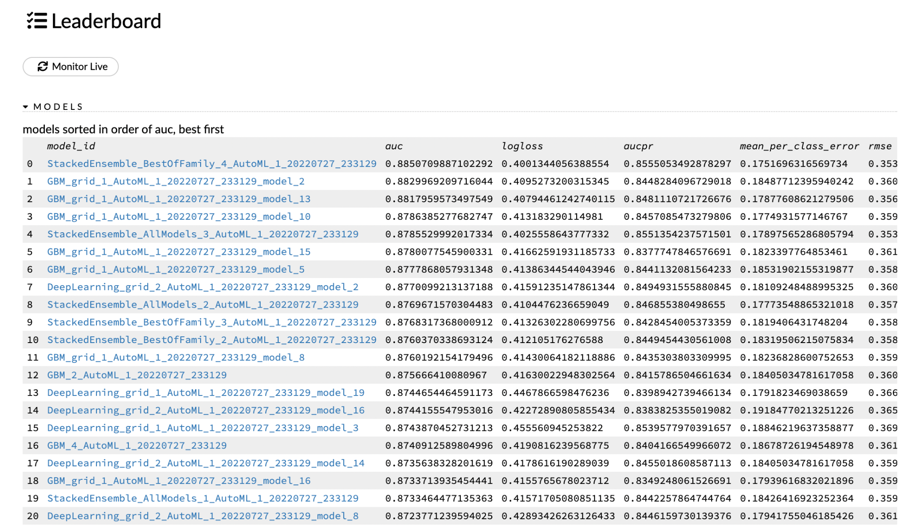
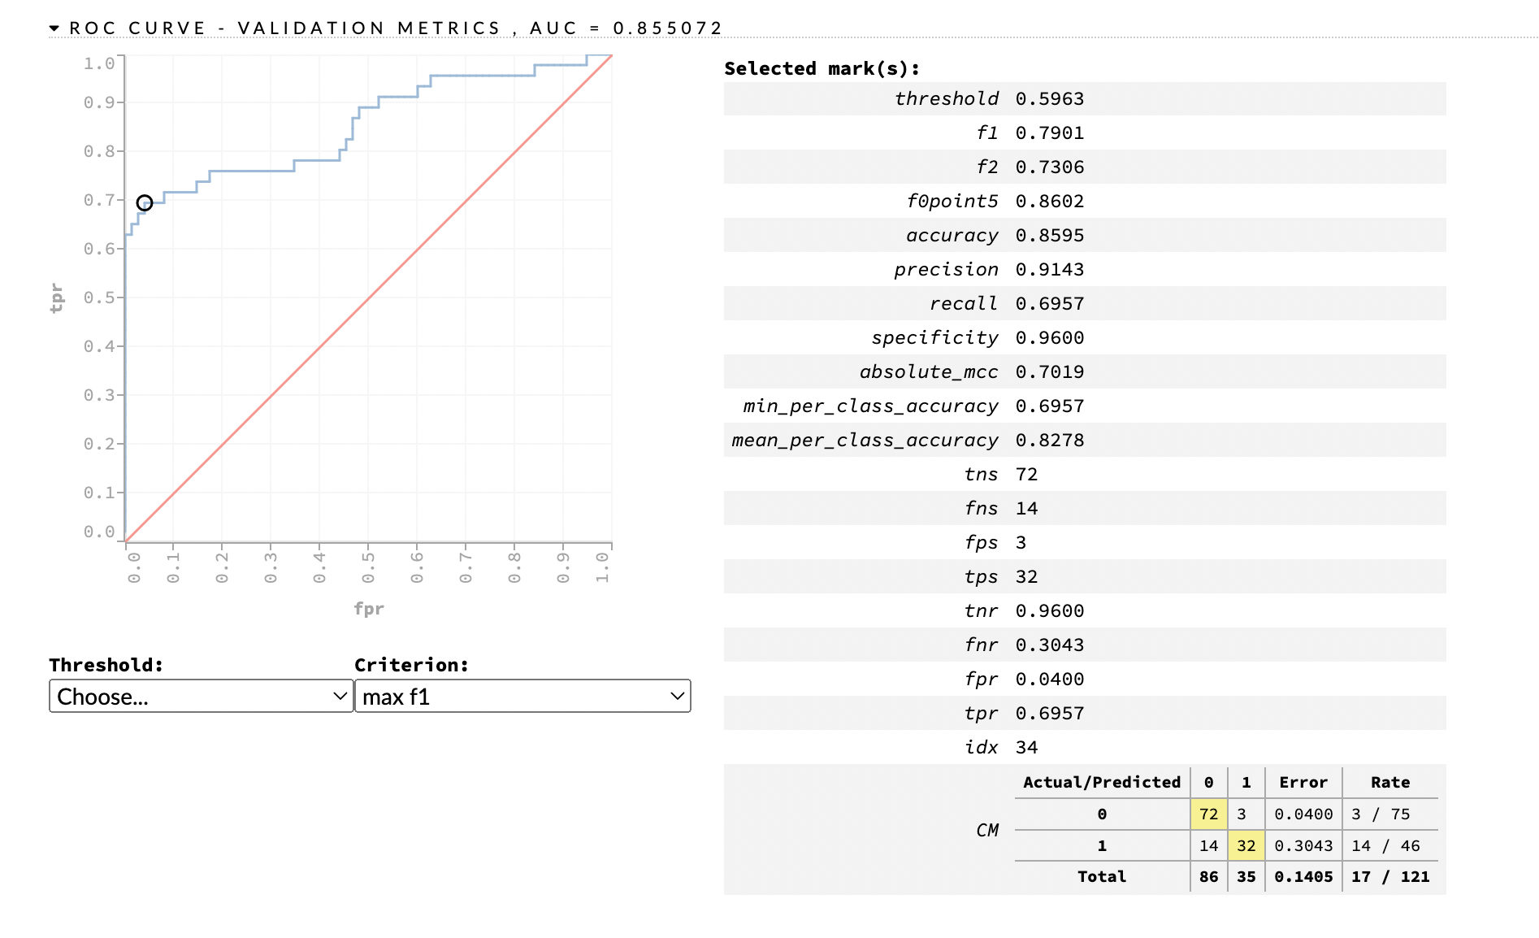
Feature Engineered + Auto ML

Slide 11
What is most important for ML Model?
Data
Good quality data/label
EDA - Imputation, Outlier Detection
Feature Engineering
Domain Understanding (SMEs)
Models
Hyper-parameter Tuning
Trying different Model types (Auto ML)
Metrics
ML Metric
Business Metric
Model Performance in real world
Model Performance Monitoring on ground truth

Slide 12
How could Jack survived with Rose?

Slide 13
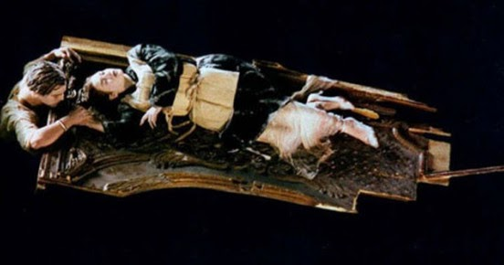

Slide 14
Questions

